Slide 1

COVID AND PNEUMONIA ANALYSIS THROUGH CHEST X-RAY
PRESENTED BY:
U. Venakata Sai - 198W1A0557 G. Chaitanya - 198W1A0517
M. Sarath - 198W1A0533
G. Prathap - 198W1A0516
GUIDED BY:
Dr K. Praveen Kumar
Sr. Assistant Professor

Slide 2

ABSTRACT
As of April 2022, more than 190 million confirmed cases had been found across the globe, according to latest figures. The number of occurrences continues to rise. The proposed study seeks to diagnose Pneumonia and Covid patients using Chest X-Rays. Using a database of chest X-Ray pictures from genuine patients, the model acknowledges Pneumonia and Covid patients. Images are pre-processed and properly trained for categories such as Normal, Pneumonia and Covid-19. CNN allows the model to learn positioning and scaling the variant structures of the data which is required to perform various data augmentation techniques. Deep learning which is essentially a neural network with three or more layers attempts to match its ability by allowing model to learn from large amounts of data.
Keywords : Covid-19, Pneumonia, Chest X-ray, Convolutional Neural Network, Deep Learning.

Slide 3
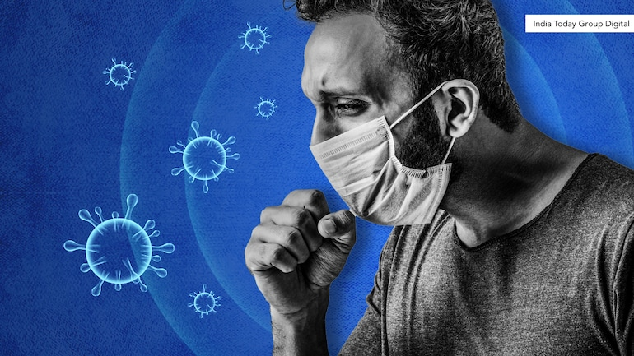
PROBLEM STATEMENT
The pandemic of COVID-19 has caused 122.7 million infections worldwide to date. Considering the fact that this virus is extremely transmissible, a timely, fast and sensitive prognosis technique is of crucial importance to help the radiologists to diagnose COVID-19 and Pneumonia within less span and by taking less effort. The idea is to identify COVID-19 and Pneumonia Infected patients using chest X-Ray images with the help of CNN.

Slide 4

MOTIVATION
For detection of COVID-19 and other pulmonary diseases the best method is CT-SCAN. One who undergoes CT-SCANNING, has reports regarding scanning and waits for the doctor to be examined. But this is vey time taking process, so we are developing a process so that it makes an individual with minimal knowledge regarding operating a computer able to detect the presence of COVID-19 and other pulmonary related diseases, which takes less time and less amount of money.

Slide 5
OBJECTIVES
To detect Covid-19 and Pneumonia using Chest X-Ray image.
To develop an user interface which is reliable and scalable as possible.
To reduce the time taken for analysing the Chest X-Ray images.
SCOPE
This model only predicts the common diseases using Chest X-Ray images (Covid-19 or Pnuemonia)
It doesnot specify the subtypes of Pnuemonia such as bacterial or virus infection.

Slide 6
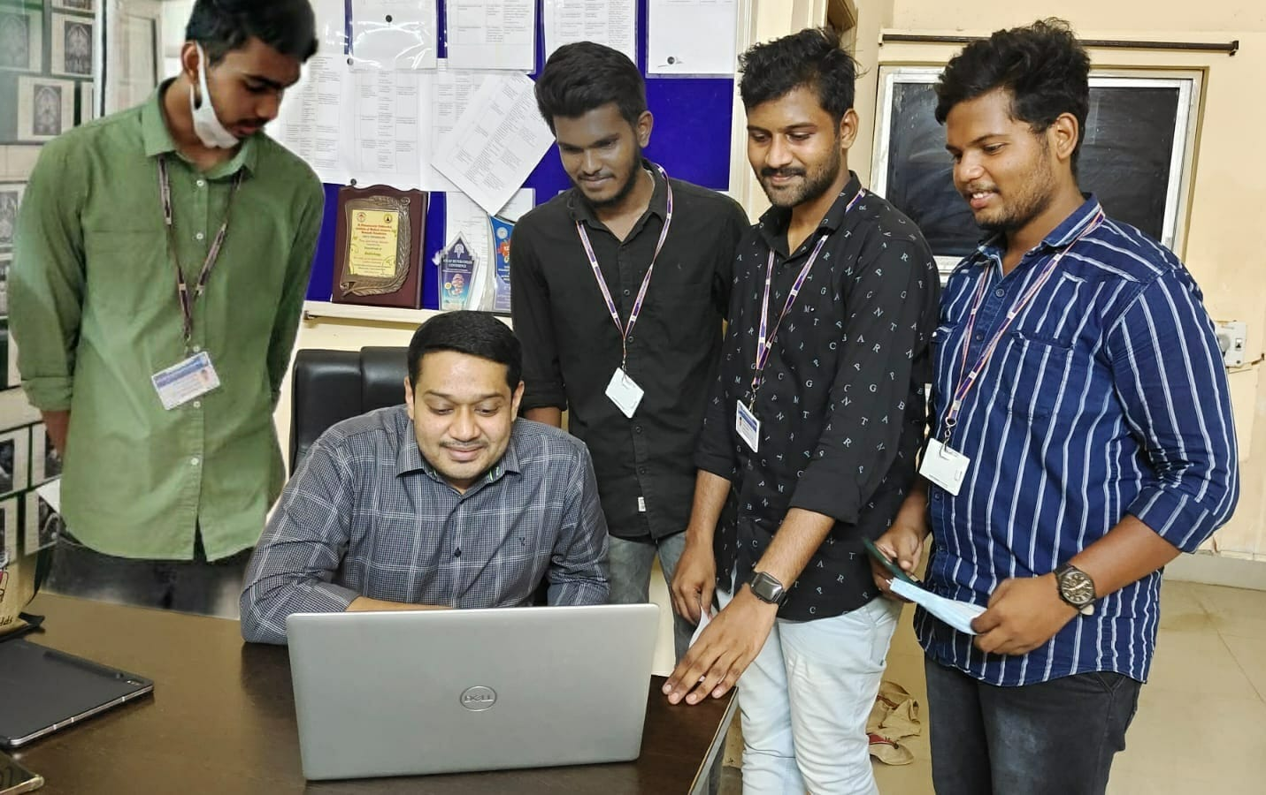
DETAILS OF THE CLIENT:
Name of the client : Dr. Srikanth
Place of the client : Pinnamaneni Siddhartha Medical College
Disease being discussed : Covid-19, lung diseases

Slide 7
Pulmonary Diseases and their Symptoms
Covid
Difficulty breathing or shortness of breath
Loss of speech or mobility, or confusion
Chest pain
Pneumonia
Cough, which may produce phlegm.
Fatigue
Chest Pain while breathing

Slide 8
Literature Survey
Detecting Covid-19 and community acquired Pneumonia using chest CT scan images deep learning^{[1]}
Methodology:
They proposed a two-stage Convolutional Neural Network (CNN) based classification framework for detecting COVID19 and Community Acquired Pneumonia (CAP) using the CT scan images.
In the first stage, an infection - COVID-19 or CAP, is detected using a pre-trained Dense Net architecture. Then, in the second stage, a fine-grained three-way classification is done using Efficient-Net architecture.
The proposed COVID+CAP-CNN framework achieved a slice-level classification accuracy of over 94% and validation accuracy of over 89.3% at the finer three-way COVID-19, CAP, and healthy classification.
Advantages:
Individual slices of CT scans are labeled using fine-tuned DenseNet based deep-learning architecture.
A fine-grained differential classification in three classes, i.e., COVID-19, CAP, and healthy individuals, by fine tuning the Efficient Net architecture
Disadvantages:
Drawback of the best performing techniques is their immense number of parameters which directly influence their footprint and latency.

Slide 9
Covid-19 diagnostic using 3D Deep transfer learning for classification of volumetric computerized tomography chest scans ^{[2]}
Methodology:
They exploit a 3D Network based transfer learning approach to classify volumetric CT scans with a novel pre- processing method to render the volume with salient features.
This work uses the pre-trained 3D ResNet50 as the backbone network.
The final testing results have shown an overall accuracy of 85.56% with the COVID-19 sensitivity attaining 82.86%.
Advantages:
An overall classification accuracy of 85.56% was achieved. The sensitivity for COVID-19, CAP and NP was 82.86%, 80.00% and 91.43% respectively
As there has not yet been many studies that investigate 3D networks for patient-wise COVID-19 prognosis, our solution has provided a promising approach.
Disadvantages:
The heavy computational loads can be mitigated via optimising the algorithm.

Slide 10
3D Convolutional Neural Networks for Automatic Detection of Pulmonary Nodules in Chest CT^{[3]}
Methodology:
There are 2 stages here. The first stage consists of a 3D fully convolutional network (FCN) for fast screening and generation of candidate suspicious regions.
The second stage consists of an ensemble of 3D CNNs trained using extensive transformations applied to both the positive and negative patches to augment the training set and can achieve 91% sensitivity at 2 false positives per scan on cases from the LIDC dataset.
Advantages:
Medical datasets typically contain a small number of samples which makes training deep networks with high number of parameters.
We have demonstrated that the combination of the network architectures and our training strategy can overcome all the limitations.
Disadvantages:
Increase the workload of radiologists and make the manual reading of screening exams very time consuming.

Slide 11
Prediction of COVID-19 Using Genetic Deep Learning Convolutional Neural Network (GDCNN)^{[4]}
Methodology:
This study aims to provide a solution for identifying pneumonia due to COVID19 and healthy lungs (normal person) using CXR images.
In this research, the state-of-the-art techniques used is Genetic Deep Learning Convolutional Neural Network (GDCNN).
It is trained from the scratch for extracting features for classifying them between COVID-19 and normal images.
Advantages:
In this research, the GDCNNN method is proposed for classifying COVID-19 and normal person, and it is done through CXR image samples.
It is clear from the analysis table that the proposed method outperforms well than compared to the existing model.
Disadvantages:
Increase the workload of radiologists and make the manual reading of screening exams very time consuming.

Slide 12
Classifying COVID 19 pneumonia ^{[5]}
Methodology:
They identified a suitable Convolutional Neural Network (CNN) model through initial comparative study of several popular CNN models.
Performs in considerable levels of COVID-19 detection against pneumonia or normal for all three lung image modes with the precision of up to 86% for X-Ray, 100% for Ultrasound and 84% for CT scans.
Advantages:
Isolated the lung field by segmentation for all image samples in order to remove noise and further reduce sampling bias.
With transfer learning provides a fast and simple to implement machine learning model for multiple imaging modes providing good results that may lead to clinically useful diagnostic tools.
Disadvantages:
Experiment 1A/2A yielded lower F1 scores and higher false negatives than experiments 1B/2B was unexpected since the manifestation of COVID-19.

Slide 13
Detecting Covid-19 and community acquired pneumonia using chest CT scan images with deep learning^{[6]}
Methodology:
They proposed a multimodal deep learning method using concatenation of extracted features from two different transfer learning model for classifying COVID-19 Pneumonia with two biomarkers, CT-Scan and X-Rays.
These biomarkers are frequently used to diagnose diseases that attack the human respiratory system and each of these biomarkers does not depend on human age.
In this research, they have used two open-source datasets and balanced the allocated for each class.
Advantages:
Easy to detect the disease.
can identify other disease and their stage of growth
Disadvantages:
Drawback of the best performing techniques is their immense number of parameters which directly influence their footprint and latency.
.

Slide 14
Multimodal Deep Learning for Diagnosing COVID-19 Pneumonia from Chest CT-Scan and X-Ray Images^{[7]}
Methodology:
They have used DenseNet121, MobileNet, Xception, InceptionV3, ResNet50, and VGG16 models for image recognition in their work.
As a result, they achieve the best classification accuracy of 99.87% of the concatenation of ResNet50 and VGG16 networks.
They also achieved the best classification accuracy of 98.00% when using a single modality of CT-Scan ResNet50 networks and classification accuracy of 98.93% for X-Ray VGG16 networks.
Advantages:
This research uses open-source datasets which consist of 2500 chest CT-Scan images.
Disadvantages:
The original size and number of the channels of the data images from both datasets are varied.
Some of the Transfer learning models that are used in this work are Dense Net.

Slide 15
Deep Learning for Classification and Localization of COVID-19 Markers in Point-of-Care Lung Ultrasound^{[8]}
Methodology:
They presented a novel fully-annotated dataset of LUS images collected from several Italian hospitals, with labels indicating the degree of disease severity at a frame-level, video-level, and pixel-level (segmentation masks).
Leveraging these data, they introduced several deep models that address relevant tasks for the automatic analysis of LUS images.
Finally, they benchmarked state of the art deep models for estimating pixel-level segmentations of COVID-19 imaging biomarkers.
Advantages:
It is quicker, cheaper and superior to MRI scanning
The CT technique eliminates superimposition of images of undesired structures completely.
Disadvantages:
It is time consuming.
The patient is exposed to higher radiation.

Slide 16
BASIC CONCEPTS
Convolution Neural Network
A convolutional neural network (CNN) is a type of artificial neural network used in image recognition and processing that is specifically designed to process pixel data.
Deep Learning
Deep learning is a type of machine learning and artificial intelligence (AI) that imitates the way humans gain certain types of knowledge. Deep learning is an important element of data science, which includes statistics and predictive modeling.
Chest X-ray
A chest radiograph, called a chest X-ray, or chest film, is a projection radiograph of the chest used to diagnose conditions affecting the chest, its contents, and nearby structures.
Flask:
Flask is a small and lightweight Python web framework that provides useful tools and features that make creating web applications in Python easier. It gives developers flexibility and is a more accessible framework for new developers since you can build a web application quickly using only a single Python file.

Slide 17
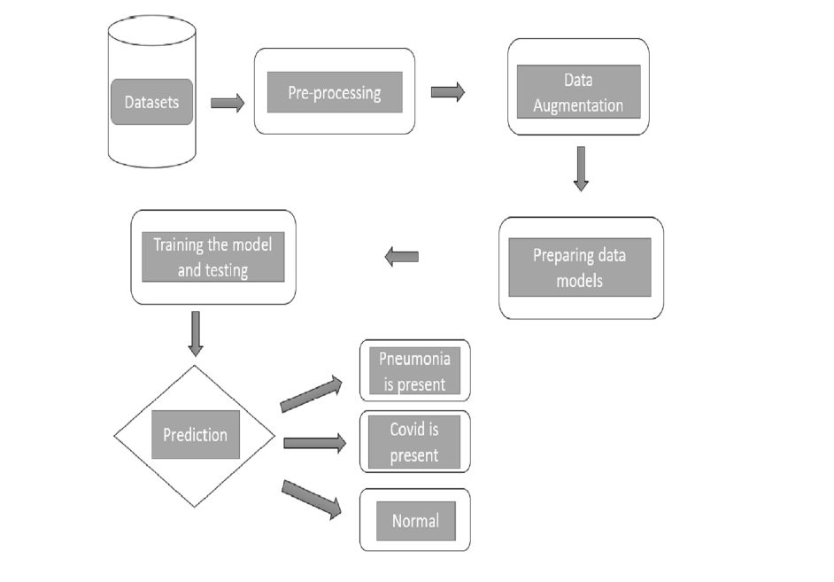
PROPOSED SYSTEM

Slide 18
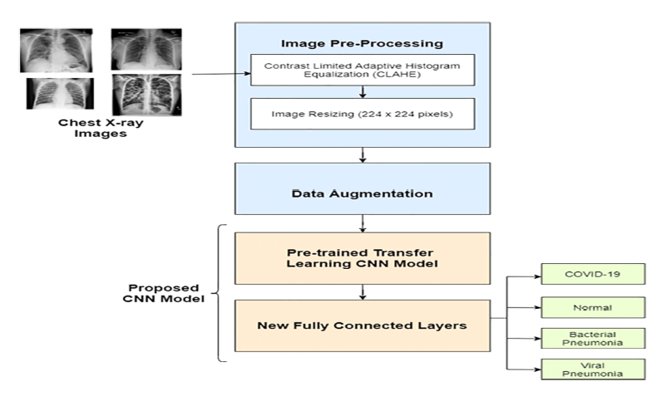
BLOCK DIAGRAM

Slide 19
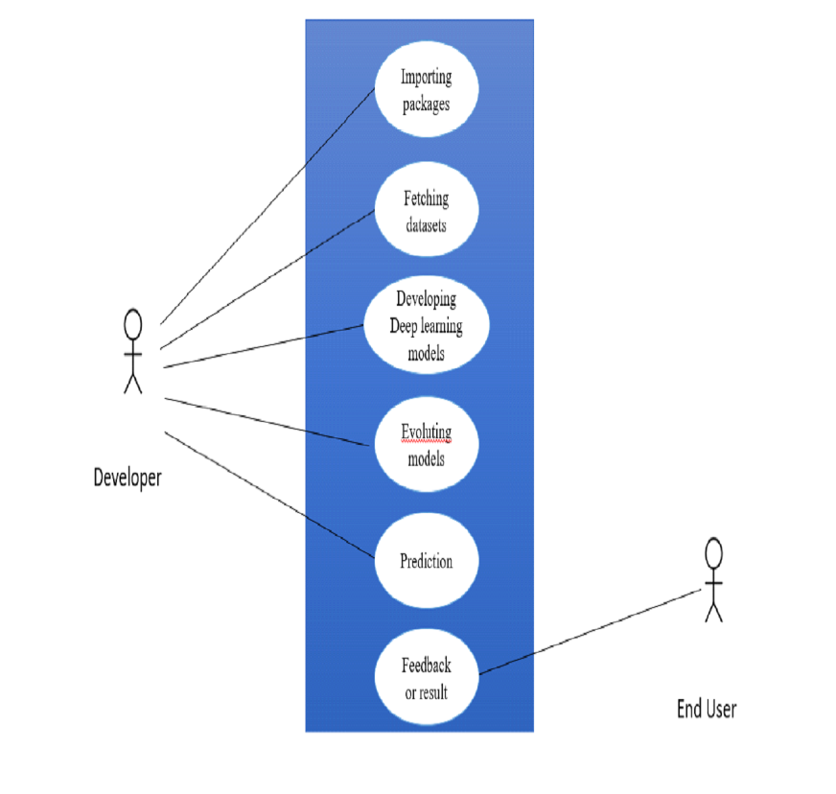
USE-CASE DIAGRAM

Slide 20
Modules
We have divided our project into 3 modules, they are:
Development Module
Pre-Processing the Data.
Training the Dataset.
Web Application Module
Link the Web application.
Implementation and testing Module
Test the Whole Project by using different Blood Test values in the Testing Data Form.

Slide 21
Development Modules
Development Module consists of mainly two subparts, they are:
Pre-Processing the Data
Training the Dataset using ML Algorithms
Pre-processing the Data:
The process of changing raw data into a usable, intelligible format is known as data preparation.
Data pre-processing tackles these problems by making datasets more full and efficient to analyze. It’s an important step that can make or break data mining and machine learning projects.
After we’ve completed the data augmentation, we’ll need to import the datasets and assign them to three separate variables for validation, testing, and training.

Slide 22
Development Modules
After that, we’ll create a deep learning model for analysing the datasets. We use
the VGG16 model for Pneumonia classification, and the Resnet model for classification.
We use two Pneumonia classification classes (Pneumonia and normal) and
three Covid-19 classification classes (Covid-19, normal, and severe). Pneumonia
caused by a virus).
Training the Dataset :
After we’ve prepared the model, we’ll train it using the datasets we’ve collected.
We will now test the model using collected data.
We will now design a web interface to assist typical users, as we are done with the training and testing of datasets with great accuracy.

Slide 23
Web Application Module
User Interface:
We are presently expanding the basic program to the next step so that it may be utilized by ordinary users for Pneumonia and Covid-19 analyses through our website.
The web interface is built using HTML, CSS, and FLASK languages for the development of our model.
The website simply has a home page on which the visitor is asked to choose the image for which analysis should be performed.
Based on the image given as input the disease is predicted using the developed model.

Slide 24
Implementation and testing module
In this module we train the data with the help of the Convolution Neural networks .
Then the implementation code will be integrated with the Web application.
The web application is made available for the users.
The user can access the website and use it for the prediction
The user simply selects the chest X-Ray image from his device and submit to the website.
The test result of the given image is displayed to the user.

Slide 25
Dataset collection
Dataset contains a large number of Chest X-Ray images which are divided and labelled into 3 different categories.
Kaggle was used to acquire a large number of datasets.
The data is divided into three categories:
Training Set
Testing Set
Validation Set
Link: https://www.kaggle.com/code/karan842/pneumonia-detection-transfer-learning-95-acc/data

Slide 26
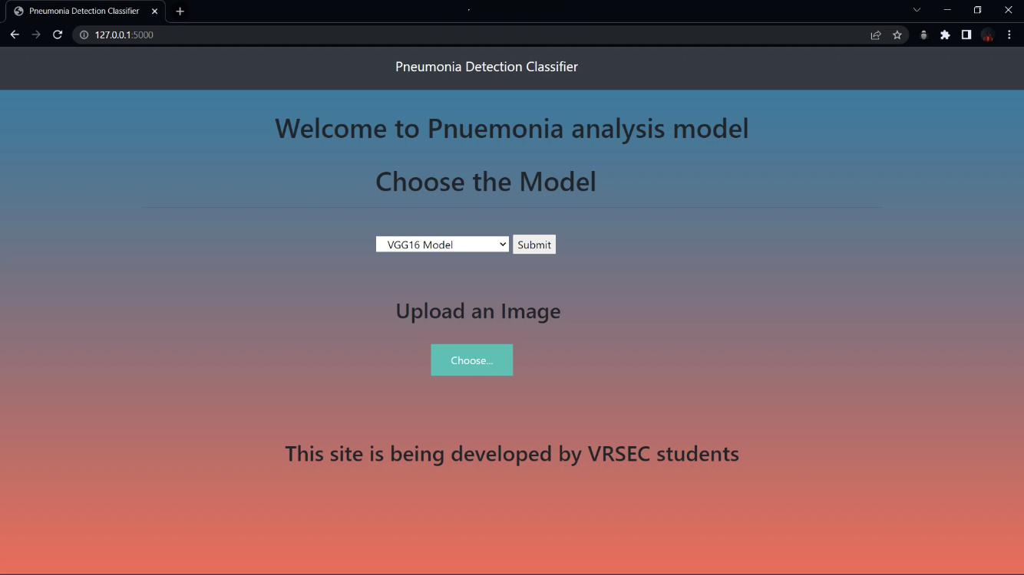
Output Screenshots
Pneumonia Web Interface:

Slide 27
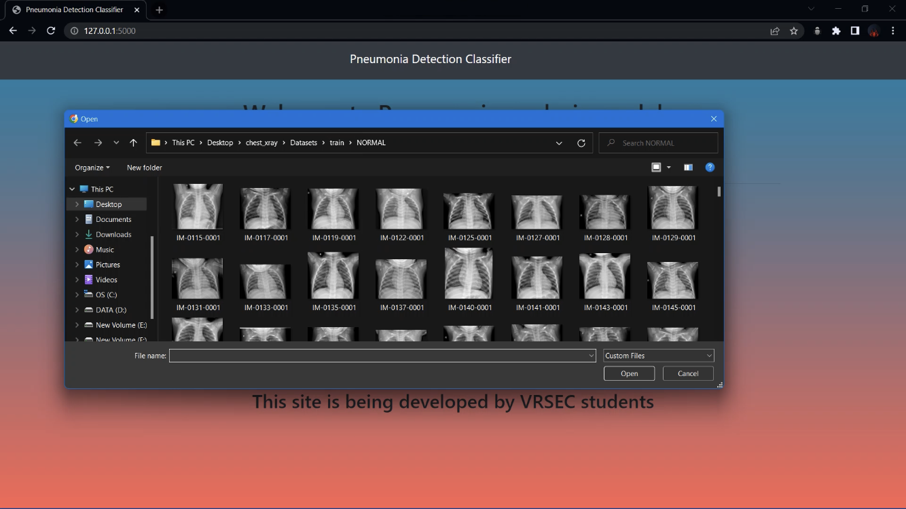
Output Screenshots
Selecting an image from the dataset:

Slide 28
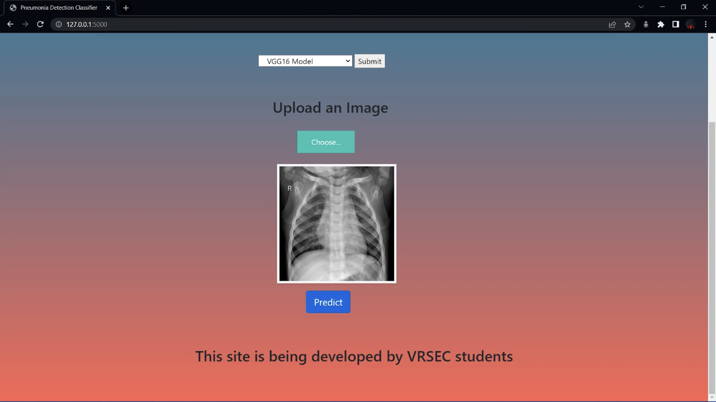
Output Screenshots
Uploading the selected image:

Slide 29
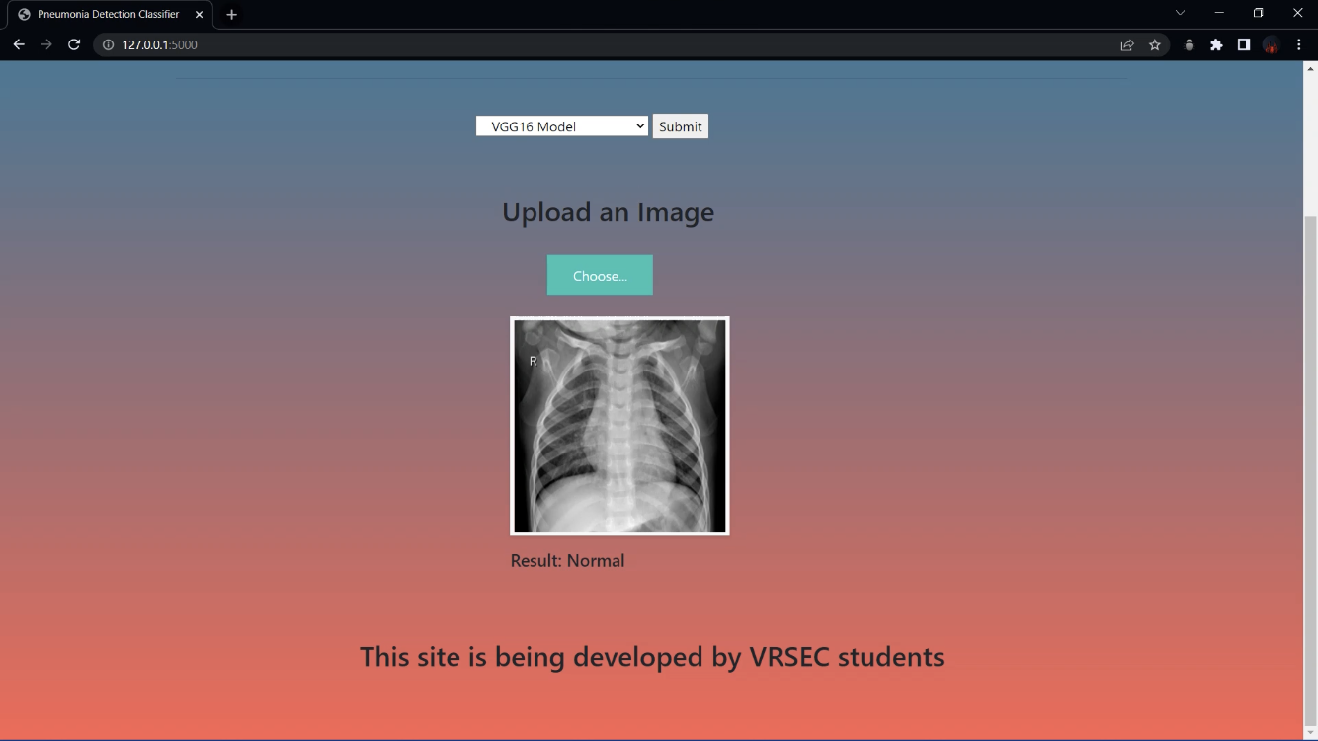
Output Screenshots
Displaying the result:

Slide 30
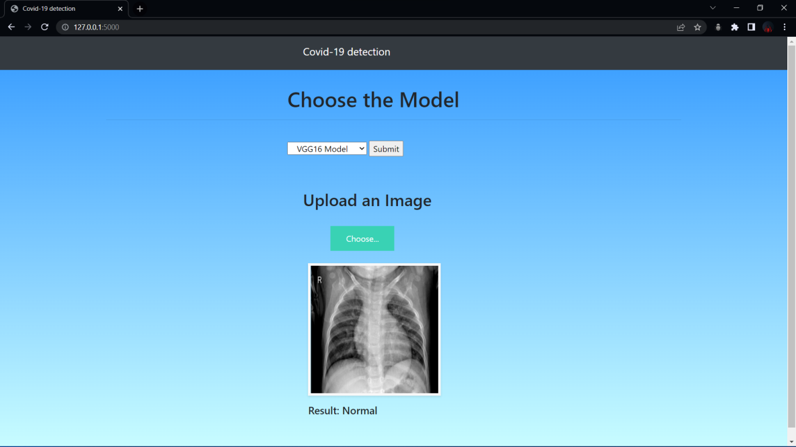
Output Screenshots
Covid-19 Web Interface:

Slide 31
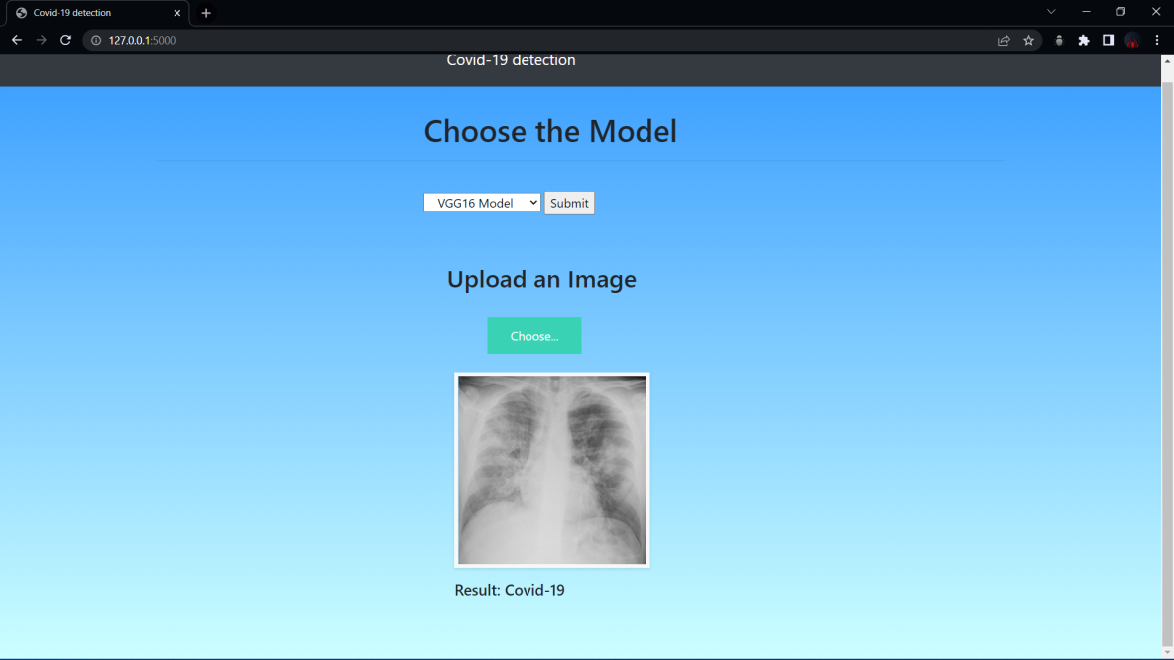
Output Screenshots
Covid-19 Web Interface:

Slide 32
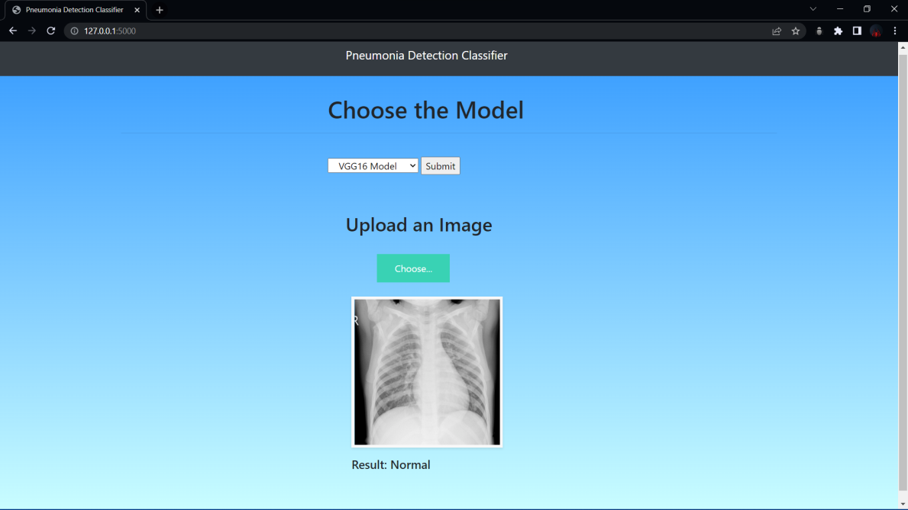
Output Screenshots
Covid-19 Web Interface:

Slide 33
Conclusion and Future work
From Chest X-Ray images, the proposed study seeks to detect Normal lungs, Covid19 Infected lungs and Pneumonia Infected lungs.
The CNN model is used to distinguish between normal and infected patients, such as COVID-19 infected lungs and Pneumonia infected lungs.
This model can be used by the common users by simply visiting the website we have been developed and able to predict the type of disease defined.
Though we have developed the model for analysis, we are attempting to integrate the covid-19 and Pneumonia classification
in order to operate in the same domain in the future.
We intend to provide an easy-to-use GUI for analyzing pneumonia and Covid-19, which will aid in resolving the problems that individuals encounter in diagnosing these diseases. This model will be trained with a real-time dataset in the future to provide more accurate predictions in a short period of time.

Slide 34
References
[1] X. Xu, X. Jiang, C. Ma et al., ”A deep learning system to screen novel coronavirus disease 2019 pneumonia”, Engineering, 2020.
[2] S. Wang, Y. Zha, W. Li et al., ”A fully automatic deep learning system for COVID-19 diagnostic and prognostic analysis”, European Respiratory Journal, vol. 56, no. 2, 2020.
[3] G. Huang, Z. Liu, L. Van Der Maaten and K. Weinberger, ”Densely connected convolutional networks”, Proceedings of The Ieee Conference On Computer Vision And Pattern Recognition, pp. 4700-4708, 2017.
[4] R. Hu, G. Ruan, S. Xiang, M. Huang, Q. Liang and J. Li, ”Automated Diagnosis of COVID-19 Using Deep Learning and Data Augmentation on Chest CT”, medRxiv, 2020.
[5] H. X. Bai, R. Wang, Z. Xiong et al., ”AI augmentation of radiologist performance in distinguishing COVID-19 from pneumonia of other etiology on chest CT”, Radiology, vol. 296, no. 3, pp. E156-E165, 2020.

Slide 35
References
[6] Noh, Hyeonwoo, et al. ”COVID-19 situation reports”, Available: Coronavirus Update (Live): 135479027 Cases and 2932008 Deaths from COVID19 Virus Pandemic - World meter (worldometers.info), 2020.
[7] H. Kang, L. Xia, F. Yan et al., ”Diagnosis of coronavirus disease 2019 (covid-19) with structured latent multi-view representation learning”, IEEE Transactions on Medical Imaging, vol. 39, no. 8, pp. 2606-2614, 2020
[8] O.A. Ramwala, H. Mulchandani, P. Dala, M.C. Paunwala and C.N Pinwale, ”COVID-19 Diagnosis from Chest Radiography Images Using Deep Residual Network”, 2020 11th International Conference on Computing Communication and Networking Technologies (ICCCNT), 2020.
[9] R. Sethi, M. Mehrotra and D. Sethi, ”Deep Learning based Diagnosis Recommendations for COVID-19 Using Chest X-Rays Images”, 2020 Second International Conference on Inventive Research in Computing Applications (ICIRCA), pp. 1-4, 2020.

Slide 36


